Slide 1
A Focus on Comprehension
Brownsville ISD
6-12

Slide 2
A Focus on Comprehension
% Students in District Meeting Target
Notes:
Say: This graph is a simple representation of very complex data. It is essentially combined scores for the district at each grade level of students meeting the target for Understanding / Analysis across Genres, of Literary Texts and Informational texts.
Basically, what we can glean from this, is that many of our students struggle with comprehension.

Slide 3
A Focus on Comprehension
District TLI Goal Grades 6-8:
Increase the number of students who achieve mastery so that 70% of students increase in Comprehension in order to meet AYP and track student progress/performance and close the gap as measured on items assessing Figure 19 of 2013 STAAR assessment.
Notes:
Read slide.

Slide 4
A Focus on Comprehension
District TLI Goal Grades 9-12:
Increase the number of students who achieve mastery of inferring so that 70% of students are successful as measured on items assessing Figure 19, RC(B) on the 2013 STAAR assessment. This will ensure that students meet AYP.
Notes:
Read slide.
Say: These are lofty goals. For us to make this type of significant change in student achievement, we will need to make a significant change in our instruction. It is clear that what we are doing isn’t working for the students in our classroom. It’s not that there is something wrong with our teaching, instead, we need to think about changing our system so that we can find a way to best meet the needs of the students in our classrooms. One way to accomplish this is to strive for consistency and alignment in our approach to instruction across all age/grade levels and across the district.
Provide an example of how alignment and consistency in instruction is helpful to our students.
Say: This type of alignment and consistency is going to require some change. Researchers of the top performing school systems tell us, “The only way to improve outcomes is to improve instruction”(McKinsey & Company, 2007, p. 29).
Today we will begin this journey of aligning our instruction with a focus on improving comprehension.

Slide 5
How can content-area, non-reading specialist teachers influence and support improvement in the academic literacy of adolescent learners?
We can begin by implementing consistent, aligned, research-based instructional approaches, routines and strategies across grade levels and content areas.
Notes:
Read slide.

Slide 6
A Focus on Comprehension
Instructional Routines | Cognitive Strategies
Reading With Purpose | Making Connections
Think-Turn-Talk | Creating Mental Images
Cognitive Strategy Routine | Making Inferences & Predictions
 | Asking & Answering Questions
Listening Comprehension | Determining Importance & Summarizing
Notes:
Say: Our focus on comprehension will begin with some basic scaffolds for students. Instructional routines. One of the key ways we can support student learning. We have 3 modules which address instructional routines: Reading With Purpose, Think-turn-Talk and Cognitive Strategy Routine. We also have a routine for enhancing the Listening Comprehension of our younger students.
We then have five modules that address the cognitive strategies that researchers have proven to be most effective for supporting student comprehension. Areas most week across grade levels are:
Making Connections, Making Inferences, Summarizing/Main Idea
Say: So what are the benefits of implementing the routines and strategies addressed in these modules across the age/grade levles?
Improves the reading achievement of all students
Provides teachers with a framework for instruction to meet the ELAR TEKS & SLAR TEKS
Impacts the quality of instruction while focusing on comprehension
Provides consistent routines in which scaffolded opportunities are embedded to meet the needs of all learners
Influences student achievement in all subject areas
Let’s begin by laying the foundation to strong comprehension instruction by looking at our first module, Reading With Purpose.

Slide 7
Reading With Purpose
Brownsville ISD
6-12
Notes:
Welcome participants.
Let’s begin by reviewing the materials you need for this training.
(Hold items up as you talk.)
Say: You will have two sets of handouts. You should have one set that says Reading With Purpose PowerPoint Presentation, and one that says Additional Handouts. You also have a Going From Good to Great card.

Slide 8

“69% of 8th grade students fall below the proficient level in their ability to comprehend the meaning of text. Reading ability is a key predictor of achievement in mathematics and science. Many adolescents need to improve their reading comprehension skills before they can take full advantage of instruction in the content areas.”
Doing What Works, U.S. Department of Education
Notes:
Read slide.

Slide 9
Notes:
Read slide.
Provide a few moments for participants to review the handout (handout #1 in the Additional Handouts).

Slide 10
Big Ideas
Instructional purpose
Supporting comprehension and increasing motivation
Setting one “Great” question prior to reading
Notes:
Read slide.

Slide 11
Session Goals
Clarify the importance of having a purpose for reading.
Explore Comprehension Purpose Questions.
Practice a process for setting Comprehension Purpose Questions.
Evaluate potential Comprehension Purpose Questions.
Select quality Comprehension Purpose Questions.
Notes:
Read slide.

Slide 12
Purpose for reading?
Why should we set a
Notes:
Read slide.

Slide 13
Comprehension
“Comprehension is the reason for reading. If readers can read the words but do not understand what they are reading, they are not really reading.
Good readers are both purposeful and active.”
(CIERA, 2003)
Notes:
Read quote.
Click to highlight the words “purposeful” and “active.”
Say: Guiding students to set a purpose for reading can help them to be both purposeful and active.
Before we discuss how we do this for our students, let’s look at how having a purpose impacts our own reading.

Slide 14

Activity
Handout #2
Read The House silently.
Use a highlighter to highlight the important information as you read.
yellow
Notes:
Say: In your supply box, you will find yellow and a pink highlighters, I would like you to take out both highlighters now please.
You will use your yellow highlighter first.
Open your Additional Handouts packet. Handout #2 is titled The House. In a moment, I will ask you to read The House silently to yourself. This is an independent activity so I shouldn’t hear any talking. While you are reading, I am going to come around and hand out a card to you. Please do NOT look at the card.
I’m going to give you 3 minutes to read The House. While reading, I want you to highlight the important information in the text.
You may begin to read silently.
Hand out the Realtor/Thief cards as participants read. Ensure that each partner receives a different colored card.

Slide 15

Activity
What did you highlight and why?
Share with a partner what you thought was most important in the text.
Notes:
Read slide. Give participants 2 minutes to discuss.
Say: Did you and your partner highlight the same information? Why not?
How did you feel about this assignment?
Encourage participants to share their thoughts. (Example responses: It was difficult; the story had no point; I thought it was going to be about skipping school, but then it didn’t tell anything about that; the story was all detail.)
Say: How would you feel right now if I told you that you were to be tested on the important information in the text?

Slide 16
Activity
Read The House silently again.
What information in the story would be important to you if you were the following character?
Notes:
Say: In a moment, I will ask you to reread The House again.
Each of you has a card placed in front of you. You may now pick this card up and look at it, but be careful not to show anyone around you what the card says. This time while you read, I want you to pretend that you are the person on the card. Using your pink highlighter, highlight the information that is important.
Give participants 2-3 minutes to complete the activity.

Slide 17
Activity
As you read, use a highlighter to highlight the important information.
pink
Notes:
Say: In a moment, I will ask you to reread The House again.
Each of you has a card placed in front of you. You may now pick this card up and look at it, but be careful not to show anyone around you what the card says. This time while you read, I want you to pretend that you are the person on the card. Using your pink highlighter, highlight the information that is important.
Give participants 2-3 minutes to complete the activity.

Slide 18

Activity
What did you highlight and why?
Share with a partner what you thought was most important in the text this time.
Notes:
Read slide.
Provide time for partners to discuss.
Say: Was it easier to read this time? Did you and your partner highlight the same information?

Slide 19
Why is it important to have a purpose for reading?
Think
Turn
Talk
Notes:
Say: I want you to think about this activity (model the hand signal for think). Why is it important to set a purpose for reading? How did having a specific purpose affect your reading? Think …
Turn and talk with your partner about these questions (model the hand signal for turn-talk).
Give participants 2 minutes to complete.
Share responses to the questions. (Example responses: I was more engaged; the purpose for reading was clear; it helped to determine importance; I wasn’t as frustrated.)

Slide 20

Why should we set a purpose for reading?
Fig. 19 Reading/Comprehension Skills
Students are expected to …
6-8(A) Establish purposes for reading selected texts based on own or others’ desired outcome to ENHANCE comprehension.
Notes:
Say: We can conclude from the previous activity that having a purpose for reading is important. This importance is reflected in our state standards. The key words that we should note here are … purpose for reading … to enhance comprehension.

Slide 21
3 Types of Purpose?
What are the
Notes:
Read slide.

Slide 22
3 Types of Purpose to Consider
Author’s Purpose
  What is the author trying to say?
  Why did the author write this?
  Who is the intended audience?
Notes:
Say: As we are planning instruction, there are three types of purpose for us to consider.
When we think about the author’s purpose, we’re asking ourselves, why did this author write this? Why did the author choose this format or these words? Who is the intended audience?

Slide 23
3 Types of Purpose to Consider
Reader’s Purpose
  Why are you reading this?
  What are you hoping to find out / learn?
Notes:
Say: As readers, our purpose might be different from the author’s; that is part of the complex relationship between reader and author. For example, the author of a non-fiction book might write to share knowledge and information, but some people read non-fiction books primarily for entertainment, and secondarily to gain information.

Slide 24
3 Types of Purpose to Consider
Instructional Purpose
  How will you teach students to comprehend the text?
  What cognitive strategy(ies) are you teaching/reinforcing to make the content of the text more accessible?
  How will you deepen and extend comprehension?
  How will you motivate students to read the text?
Notes:
Say: Our students might also have a different purpose for reading than we would like them to have. Often, students’ purpose for reading is simply to finish an assignment. If we would like them to have a more focused or deeper purpose, we will have to provide instruction on the various purposes for reading. As we saw during The House activity, if a reader doesn’t know the purpose for reading, his/her ability to stay engaged and extract important information becomes compromised. This applies to our students just as it does to us.
So as instructors, we need to be sure our purpose is clear to our students.
Read slide.
Say: We’ll be spending the majority of this session discussing instructional purpose and how to make this type of purpose clearer to our students.

Slide 25
Instructional Purpose
A Focus on
Notes:
Say: When we are directly and explicitly teaching our students skills and strategies to enhance or improve comprehension, then our instructional purpose is just that - improving comprehension. As teachers, we can deepen and extend our students’ understanding of text by setting specific purposes for the reading we do as a class.
When we say, “the reading we do in class,” we are referring not only to the comprehension instruction that occurs during our core reading block, but also to our content-area reading. We are also referring to teacher read-alouds, shared reading, and independent reading.
If we want to increase our students’ understanding of all the texts they read each day, we must plan well and use questions thoughtfully. Today we are going to discuss the planning of a particular type of question. We are going to call these questions comprehension purpose questions, or CPQs.

Slide 26
Instructional Purpose
Instructional purpose includes the use of one guiding question which is set prior to reading.
Comprehension Purpose Question (CPQ)
Notes:
Read slide.

Slide 27
Comprehension Purpose Questions
Thoughtful “questions appear to be effective for improving learning from reading because they:
give students a purpose for reading;
focus students’ attention on what they are to learn;
help students to think actively as they read;
encourage students to monitor their comprehension; and
help students to review content and relate what they have learned to what they already know” (CIERA, 2003).
Notes:
Say: A thoughtful comprehension purpose question can enhance comprehension because it provides a support for students. A purpose question acts as a scaffold to help students navigate through text and to think about the critical information we want them to understand.

Slide 28
Features of Effective Instruction
Systematic Instruction With Scaffolding
“… the systematic sequencing of prompted content, materials, tasks, and teacher and peer support to optimize learning.”
(Dickson, Chard & Simmons, 1993 in Texas Education Agency/University of Texas System, 2007).
Notes:
Read slide.
Say: We want to be proactive in our teaching which means planning and selecting appropriate tasks and goals. Included are the following approaches: Supporting active participation and redirection, maintaining focus, assisting in internalization and independence. By setting a thoughtful CPQ prior to reading, we support our students to optimize learning.

Slide 29
What did the colonists do to demonstrate their opposition to the Stamp Act?
West Davidson, J. (2003). The American nation: Beginnings through 1877. Pearson Education Inc., publishing as Pearson Prentice Hall, Upper Saddle River, NJ.
Notes:
Say: Let’s take a look at some example Comprehension Purpose Questions (CPQs), to help clarify what I mean by setting one thoughtful question prior to reading and how it might look across content areas.
This example is from Us History. The text is about the Stamp Act. The CPQ, the teacher provides students prior to reading is: What did the colonists do to demonstrate their opposition to the Stamp Act?

Slide 30
What are at least two key facts you should understand about quadrants?
Larson, R., Boswell, L., Kanold, T., Stiff, L. (2007). Algebra 1(Texas Edition). McDougal Littell, a division of Houghton Mifflin Company.
Notes:
Say: Here is a math example from 10th grade Algebra.
Read slide.

Slide 31
What are the differences between the original function and the new function?
The amount an appliance repairman charges for each job is represented by the function t = 50h + 35, where h represents the number of hours he spent on the job and t represents the total amount he charges in dollars for the job. The repairman plans to change the amount he charge changes for each job. The amount he plans to charge is represented by the function t = 50h + 45. What will be the effect of this change on the amount he charges for each job?
Compare and contrast the original function and the new function.
A. The total amount he charges for each job will increase by $10. (ANSWER)
B. The total amount he charges for each job will decrease by $10. (It doesn't decrease, the hourly rate stays the same at 50, but the service fee goes up $10, from 35 to 45).
C. The amount he charges per hour will increase by $10. (The hourly rate stays the same at 50.)
D. The amount he charges per hour will decrease by $10. (The hourly rate stays the same at 50.)
Submitted by Laura Beal
Lanier High School, Austin, Texas
Notes:
Say: Here is another math example from 10th grade Algebra. This time we see how a CPQ can assist students in understanding a complex word problem. We have two possible CPQs. We would choose the one we think would be most helpful to give to our students prior to reading this problem.
Read slide.

Slide 32
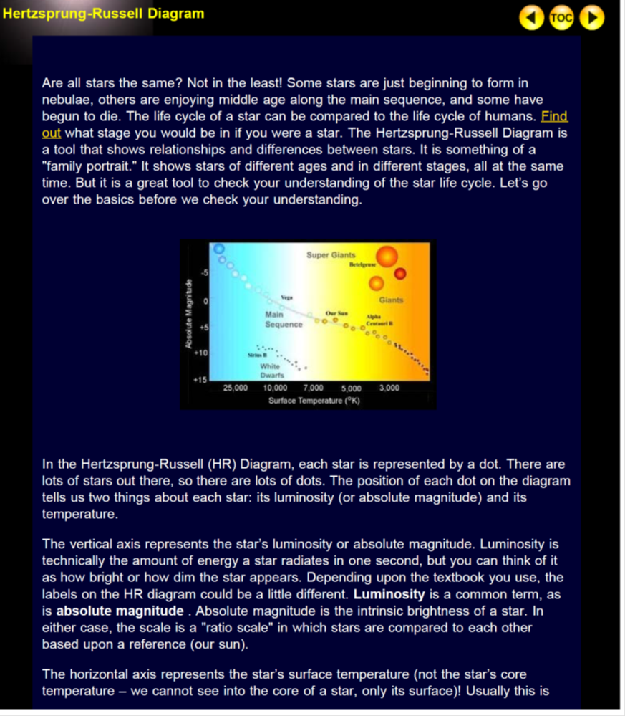
How do you read an H-R diagram and what information do you learn from using it?
http://aspire.cosmic-ray.org/labs/star_life/hr_diagram.html
Notes:
Say: This example is from science. We might ask students to read and understand how to use the Hertzsrpung-Russell Diagram. There are some key concepts we need students to understand if they are to use a H-R diagram correctly.
Read slide.
Retrieved on October 24, 2012 from http://aspire.cosmic-ray.org/labs/star_life/hr_diagram.html

Slide 33
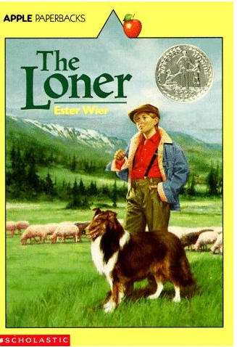
Chapter 1
CPQ:
What happens to Raidy and what effect does this have on the boy?
Notes:
Say: Here is a sixth grade ELA example. This is a book I have used many times with small groups of students and each time I have used this text in my instruction, most students have difficulty in understanding the outcome of a key event that occurs at the end of chapter one of The Loner. I set a CPQ that I know will help facilitate close reading and good discussion about the event that occurs at the end of the chapter and why this event has such an impact on the main character.

Slide 34

Setting a CPQ to Support Comprehension
“When teachers choose to incorporate text in the teaching of academic content, they have to consider the content learning goals, but also the instructional goals for helping students understand the content of the text.”
(Jetton & Lee, 2012, p. 101)
Notes:
Say: So we set a CPQ to support student comprehension. If we assign a reading to our students, it’s likely because there are some critical pieces of information we need our students to learn. If this is the case, then we need to ensure that all students will be successful at accessing the information.
Read slide.

Slide 35

Use a CPQ to Increase Motivation
“As students transition from elementary to middle and high school, their motivation drops (Guthrie & Davis, 2003). This drop may be due to a number of factors, including students’ reluctance to read the difficult textbooks they encounter in middle and high school …
Notes:
Say: We also know that motivation is a key factor for many of our students. Like the donkey in the story at the start of the presentation, many of our students see text and feel overwhelmed or turned off.
Read slide.

Slide 36
Use a CPQ to Increase Motivation
Teachers need to find opportunities to reengage these adolescent learners … They must also plan instruction that includes social interaction, so that students and teachers can employ discourse to grapple with the ideas and theories of the discipline.”
(Jetton & Lee, 2012, pp. 99-100)
Notes:
Read slide.
Say: High quality discussion not only can increase motivation but it also increases comprehension.

Slide 37
High-Quality Discussions of Text
Meta-analysis from 75 studies on discussion-oriented instruction
Most important conclusion:
  “approaches emphasizing critical analysis of the text or involving text discussion (either teacher- or student-led) of specific questions about text had the most consistently positive effect on reading comprehension outcomes.”
  (Torgesen, 2007)
Notes:
Read slide.

Slide 38
Why Should we Set a CPQ?
Think
Turn
Talk
Notes:
Read slide.

Slide 39

Why Should we Set a CPQ?
Students who struggle to comprehend are less motivated to persevere with complex text. By setting a clear purpose and by helping students to understand the objectives of the lesson, they will more likely experience success.
Allen, J. (2000)., Berkeley, S., Mastropieri, M., & Scruggs, T. (2011)
Notes:
Say: To summarize these key points, take a moment to read this slide to yourself.

Slide 40
Comprehension Purpose questions?
How do we set
Notes:
Read slide.

Slide 41



It can’t be … that hard … can it?
Notes:
Read slide.

Slide 42
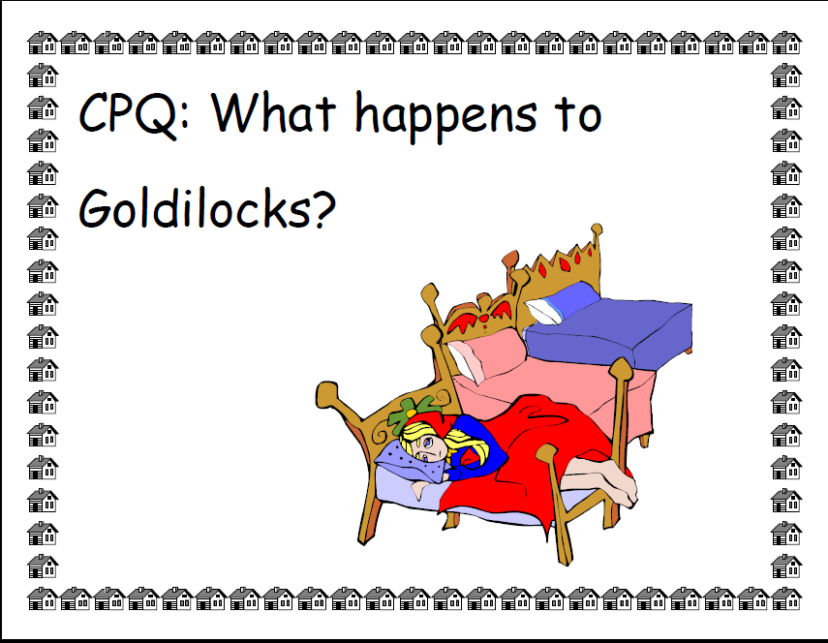
Goldilocks?
Notes:
Say: Simply asking our students multiple questions during text reading, however, may not provide enough support. It can be difficult for even experienced readers to focus on the crucial information in a piece. Therefore, we teach our students to “read with a question in mind” by setting a comprehension purpose question each time we read a text.
A comprehension purpose question, or CPQ, is a question we propose before reading, to guide our students’ thinking as they read. For example, if I’m reading the story “Goldilocks and the Three Bears” I might say to my students, “As we’re reading, I’d like you to think about the question, What happens to Goldilocks in the story?” That would be a very simple question I might pose, the first time I read the story, to help my students gain a basic understanding of the story’s events.

Slide 43
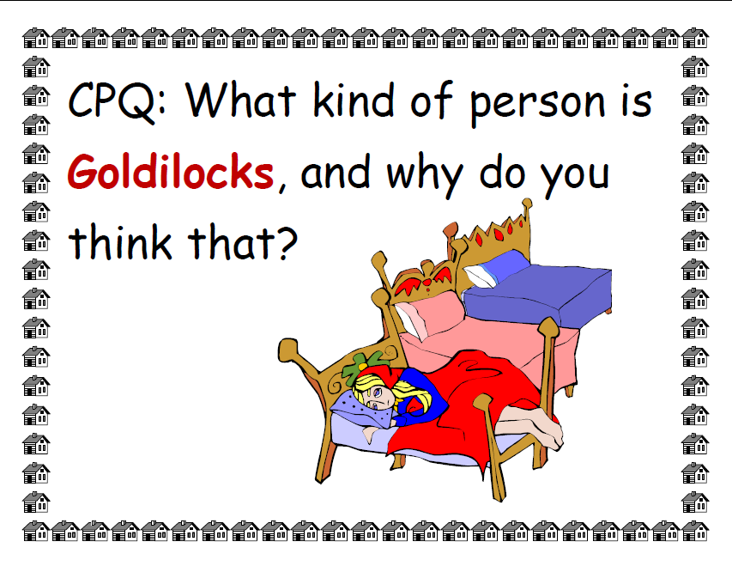
Notes:
Say: Later in the week, I might ask, “As we’re reading, I’d like you to think about this CPQ: What kind of person is Goldilocks and why do you think that?” This question will help my students deepen their understanding because now they have to think about all of Goldilocks’ actions and synthesize what those behaviors indicate to the reader.

Slide 44
What’s important to remember when setting a CPQ?
Handout #3
Notes:
Say: In just a moment we will read Handout #3 to learn a bit more about CPQs. Before reading, I would like you to notice that I have included a CPQ to help guide your thinking while reading this handout. Your CPQ is: What is important to remember when setting a CPQ?
You may wish to highlight, underline, reread etc., to assist you in identifying the key information needed to answer the CPQ.
When you have finished reading, talk to your partner about how you would answer our CPQ.

Slide 45
Discuss the CPQ
Share your understanding with a partner:
What’s important to remember when setting a CPQ?
Notes:
Allow time for participants to read and discuss.

Slide 46
What’s Important to Remember … ?
  Set a comprehension purpose question when the text includes important content all students must be able to access and understand.
  Choose a question that will focus attention throughout the reading.
  Link the CPQ to the strategy(ies) on which you’ll focus.
  Post the CPQ for students to see and refer to.
  Provide opportunities to discuss and share after reading.
Notes:
Say: As you were reading, you may have identified some of the following ideas:
Read slide.

Slide 47
Steps for Setting a Great CPQ
Record/annotate your thinking while reading the text you will ask students to read.
After reading, brainstorm possible CPQs (What do you want students to understand?).
Integrate with teacher resources if available.
Select a “Great” CPQ.
Notes:
Say: Setting good CPQs can be a challenging process. For the rest of this session we will work step-by-step through this process.
Click to emphasize step 1 on the slide.
Say: Step 1 includes recording the thinking we do the first time we read a text.

Slide 48
Steps for Setting a Great CPQ
Record/annotate your thinking while reading the text you will ask students to read.
After reading, brainstorm possible CPQs (What do you want students to understand?).
Integrate with teacher resources if available.
Select a “Great” CPQ.
Notes:
Say: Step 1 includes recording the thinking we do the first time we read a text.

Slide 49

Step 1: Record / Annotate Your Thinking
Handout #4
Notes:
Say: I’m going to model each step for you and then you will practice each step on your own. Please take out handout #4 so that you can follow along.

Slide 50
Really? Why not? I couldn’t wait to drive.

Slide 51
Texting. Facebook. Lack of in-person interaction.
20 years = 14% difference. That’s interesting.
Laws are tougher. Families have to pay.
Older because they need to get to work?
Kids are too dependent these days.
Higher standards means time commitment.

Slide 52

Step 1: Record / Annotate Your Thinking
Handout #5
Read: Watch your driving, kids. The parents are watching.
As you read, record your authentic thinking on sticky notes.
Notes:
Read slide.

Slide 53
Steps for Setting a Great CPQ
Record/annotate your thinking while reading the text you will ask students to read.
After reading, brainstorm possible CPQs (What do you want students to understand?).
Integrate with teacher resources if available.
Select a “Great” CPQ.
Notes:
Read slide.

Slide 54
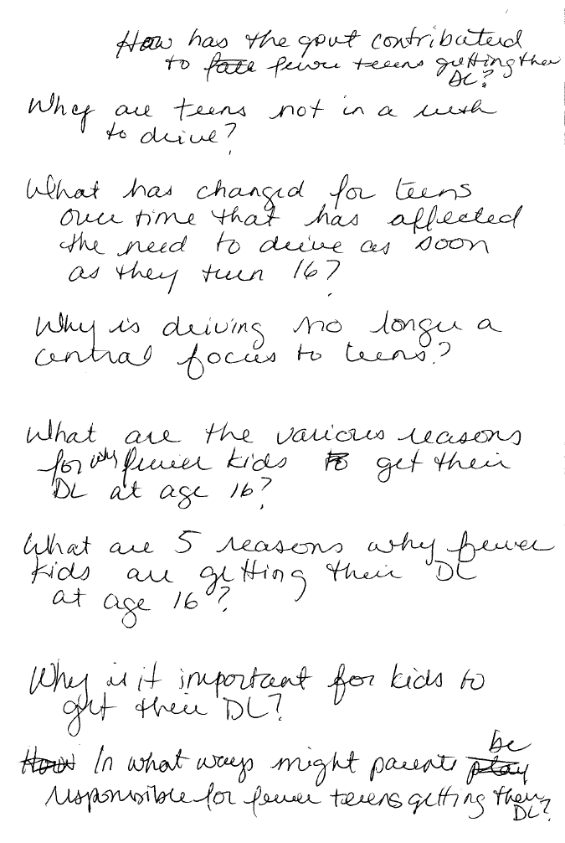
Step 2: Brainstorm Possible CPQs
Notes:
Say: Here are all of the questions that I brainstormed after reading.
Read slide.

Slide 55
Step 2: Brainstorm Possible CPQs
Review the sticky notes on which you recorded your thinking.
Think about what you would want students to understand after reading the article.
Brainstorm possible CPQs for Watch your driving, kids. The parents are watching.
Notes:
Read slide.

Slide 56
Steps for Setting a Great CPQ
Record/annotate your thinking while reading the text you will ask students to read.
After reading, brainstorm possible CPQs (What do you want students to understand?).
Integrate with teacher resources if available.
Select a “Great” CPQ.
Notes:
Read slide.

Slide 57
West Davidson, J. (2003). The American nation: Beginnings through 1877. Pearson Education Inc., publishing as Pearson Prentice Hall, Upper Saddle River, NJ.
Notes:
Say: Here is an example of a student text book with questions at the end of the selection. This may be one place you will check to find additional questions you may wish to consider for your CPQ.

Slide 58
Steps for Setting a Great CPQ
Record/annotate your thinking while reading the text you will ask students to read.
After reading, brainstorm possible CPQs (What do you want students to understand?).
Integrate with teacher resources if available.
Select a “Great” CPQ.
Notes:
Read slide.

Slide 59
Going From Good to Great!
A good CPQ:
Is answered in the text either explicitly or implicitly.
Involves student thinking.
Will focus on comprehension.
Relates to student learning.
A great CPQ:
Cannot be completely answered until students have read the entire text.
Involves higher order thinking, inferences, text evidence or synthesis of information.
Will deepen and extend comprehension. Gets at the heart of what you want students to understand.
Relates to the cognitive strategy(ies) currently being taught.
Notes:
Click for first bullet.
Say: A good CPQ is answered through reading the text. Sometimes we might think of a question that is not answered in the text, either directly or indirectly. That would not be a good CPQ. For example: if I am reading Goldilocks, “Why do the bears like porridge?” would not be a good CPQ because it is not answered in the text.
Click for second bullet.
Say: A great CPQ, however, is not answered until students have read the entire text. If a question can be answered on the first or second page, we would choose a different CPQ.
Click for third bullet.
Say: Good CPQs will lead our students to think, not just pick out details from the text.
Click for fourth bullet.
Say: A great CPQ will lead our students to use higher order thinking. They may have to make inferences, combining text evidence with their background knowledge.
Click for fifth bullet.
Say: Good CPQs help our students focus on meaning and the important information in a text.
Click for sixth bullet.
Say: Great CPQs will lead our students to understand more deeply each time they read a text. While my first CPQ might address the story as a whole, with each reading I ask my students to dig deeper and be more thoughtful in their reading.
Click for seventh bullet.
Say: A good CPQ will not just deepen understanding, but will help our students make links to information they’ve learned previously.
Click for final bullet.
Say: A great CPQ will link to a comprehension strategy or skill I’m currently teaching. For example, if I’m teaching my students to analyze characters, I might use the question, “How would you describe Goldilocks and why?” because it links to that skill.
We have provided you with a Good to Great card that you may wish to keep close by as you plan CPQs.

Slide 60
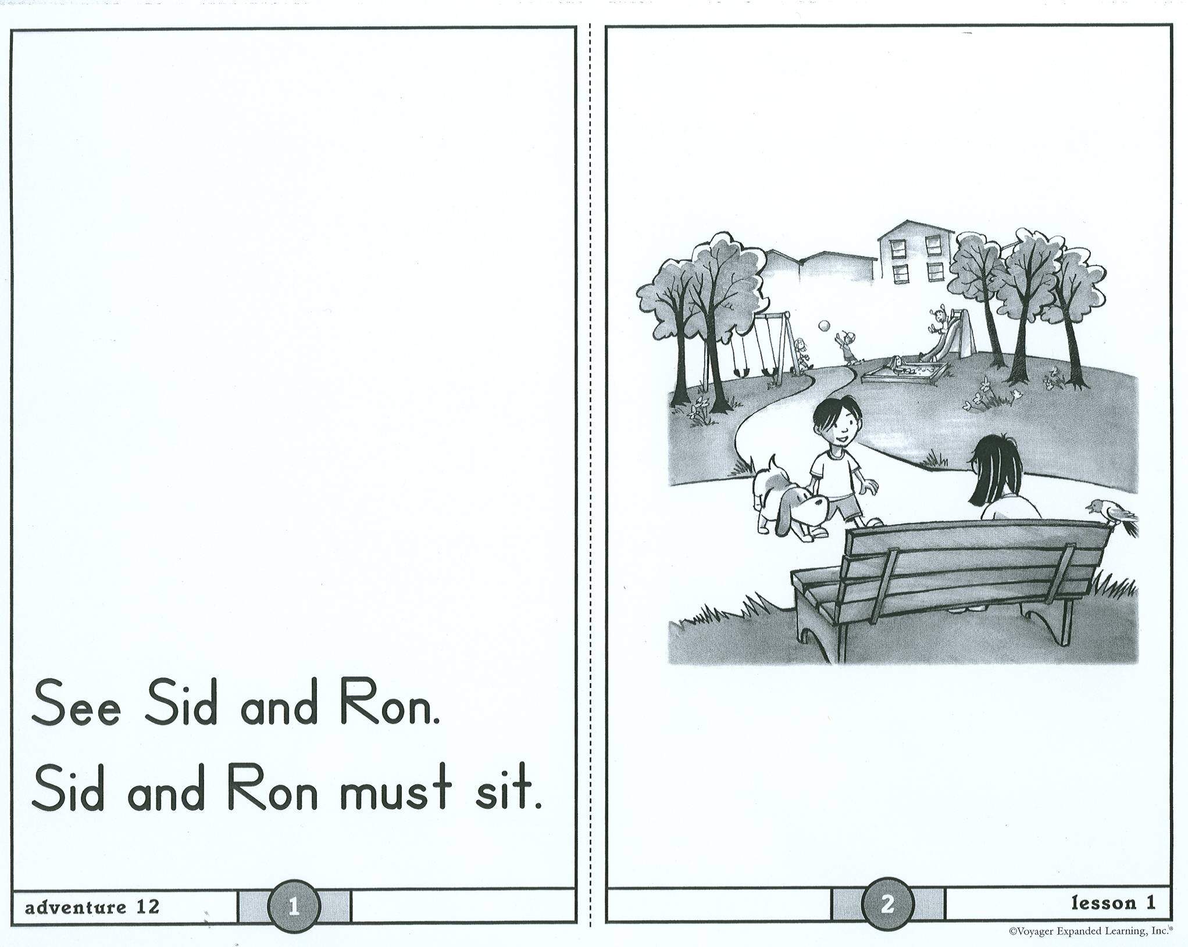
Why must Sid and Ron sit?
What do the characters have to do?
What do the children have to do?
What do Sid and Ron have to do?
Notes:
See Speaker Notes RWP Add 1.

Slide 61
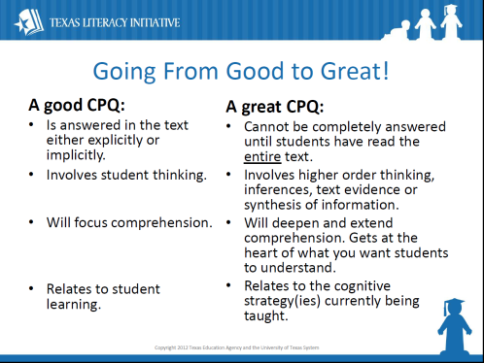
Step 4: Select a “Great” CPQ
Review your list of brainstorm questions as well as any additions from teacher resources if applicable.
Circle the question you think would make a good CPQ.
Share your CPQ with a partner. Use your Going From Good to Great! card to see if you can improve your question and make it “great.”
Notes:
Say: Now you will have the opportunity to practice step 4.
Read slide.
Provide time for teachers to choose CPQs and discuss.

Slide 62
Sample CPQs
How would you feel if your parents installed a video camera in your car?
Why do parents want to watch their kids drive?
When you have kids, will you install a video camera in their car?
What are the pros and cons of having a video camera installed in a teen’s car?
Notes:
Read the sample CPQs on the slide and use the Going From Good to Great card to guide decisions about what makes the question a good one to use.

Slide 63
Academic Disciplines
Planning CPQs Across the
Notes:
Read slide.

Slide 64
Planning a CPQ for Tomorrow’s Lesson
Select a piece of text you will assign to students in the next few days.
Follow the 4 step process to create a great CPQ for your lesson.
Use the CPQ and provide time for students to discuss their answer to the CPQ in class.
Reflect on the CPQ and revise as necessary.
Notes:
Read slide.

Slide 65
“The purpose of reading is always understanding.”
~ Harvey & Goudvis, 2007
Notes:
Say: Are there any questions?

Slide 66
References
Allen, J. (2000)., Berkeley, S., Mastropieri, M., & Scruggs, T. (2011). Reading comprehension strategy instruction and attribution retraining for secondary students with learning and other mile disabilities. Journal of Learning Disabilities, 44(1) 18-32.
Armbruster, Bonnie B. & Lehr, Fran. & Osborn, Jean. & Adler, C. Ralph. & National Institute for Literacy (U.S.). & Educational Resources Information Center (U.S.). (2003). Put reading first the research building blocks for teaching children to read : kindergarten through grade 3, (2nd ed.). [Washington, DC : National Institute for Literacy]: U.S. Dept. of Education, Office of Educational Research and Improvement, Educational Resources Information Center
Daniels, H., & Steineke, N. (2011). Texts and lessons for content-Area reading. Portsmouth, NH: Heinemann.
Doing What Works: US Department of Education. (n.d.). Adolescent Literacy Visual. Retrieved October 28, 2012, from: http://ontrack-media.net/TSLP/docs/DoingWhatWorks_visual.pdf

Slide 67
References
Jetton, T. & Lee, R. (2012). A model for teacher planning wit text in the academic disciplines. In T. Jetton & C. Shanahan (Eds.), Adolescent literacy in the academic disciplines: General principles and practical strategies (pp. 91-119). New York: NY. The Guilford Press.
Harvey, S. & Goudvis, A. (2007). Strategies that work: Teaching comprehension to enhance understanding. Portland, ME: Stenhouse Publishers.
Hertzsrpung-Russell Diagram. (n.d.). Retrieved October 24, 2012, from: http://aspire.cosmic-ray.org/labs/star_life/hr_diagram.html
Larson, R., Boswell, L., Kanold, T., Stiff, L. (2007). Algebra 1(Texas Edition). Evanston, IL: McDougal Littell, a division of Houghton Mifflin Company.
Pichert and Anderson (1977) in C. Tovani, I read it but I don’t get it: Comprehension strategies for adolescent readers. (2000). Portland, ME: Stenhouse Publishers.
Smith, L. (2010). It’s a book. New York: Roaring Book Press.

Slide 68
References
Torgesen, J. (2007). Five areas of instructional improvement to increase academic literacy. Retrieved on November 9, 2012 from http://www.adlit.org/article/19999/
Vaughn Gross Center for Reading and Language Arts. (2007). Features of effective instruction. University of Texas System/Texas Education Agency.
Voyager Universal Literacy System. Treehouse, daily reading selections, student book K. Unit 4, Seasons all around.
West Davidson, J. (2003). The American nation: Beginnings through 1877. Upper Saddle River, NJ: Pearson Education Inc., publishing as Pearson Prentice Hall.

