Slide 1
TALA Strategy: Frayer Model
Presented By: Alma Sanchez
TLI Teacher Specialist

Slide 2
Outcomes
Learn how to choose words for use of the Frayer model
Learn how to plan for vocabulary instruction
Understand the importance of quick and accurate word recognition
Learn how to make definitions useful to students
Learn the routine in teaching new vocabulary words to students.
Learn how to modify frayer model for common words

Slide 3
How Many Words Should Be Taught?
Students need to learn about 3,000-4,000 words per year to maintain average vocabulary growth
(Baumann & Kame’enui, 2004)
Many students with low vocabularies need to learn more words to make progress toward catching up with their peers.
Students must learn through direct instruction and incidentally through exposure and wide reading
Notes:
Direct instruction-teacher focused and in small groups, broken up by chunks

Slide 4
Planning for Vocabulary
When deciding whether to use the expanded instructional routine, consider whether the word is:
Critically important for comprehension
Frequently encountered
A multiple-meaning word defined differently in other contexts

Slide 5
The Importance of Quick and Accurate Word Recognition
Fluent reading (quick, smooth, accurate reading) depends on recognizing many words immediately “at sight” and efficiently identifying unfamiliar words.
(Torgesen et al., 2003)
Poorly developed word recognition skills, and a resulting lack of reading fluency, are among the greatest sources of reading challenges.
(Rasinski & Padak, 1998; Torgesen et al., 2003)
Concentrating on identifying words reduces the amount of concentration that can be devoted to comprehension.
(National Institute of Child Health and Human Development, 2000; Samuels, 2002)

Slide 6
Making Definitions Useful to Students
Looking up words in the dictionary is not effective for helping students learn new words.
(Scott & Nagy, 1997)
Teaching students only formal definitions does not significantly or reliably improve comprehension.
(Baumann & Kame’enui, 1991; Stahl & Fairbanks, 1986)
It is more useful to explain the vocabulary words in simplified, natural English terms before a reading…
(Beck, McKeown, & Kucan, 2002)
…and to use formal dictionary definitions after the word has been encountered in text.
(Nist & Olejnik, 1995)

Slide 7
Routine in Teaching New Vocabulary Words to Students
Select the words to teach
Select words for your unit that will be taught
Pronouncing and defining the words
Pronounce the word for the student(s) and have them repeat the pronunciation with you
Provide a student friendly definition of the word and check for understanding (some words may be cognates)
Generating examples and nonexamples

Slide 8
Making Examples and Nonexamples Useful
Closely related to topic and characteristics
Synonyms and antonyms
Concrete
Personally or culturally relevant

Slide 9
Frayer Model: Language Arts
Definition A writer’s account or memories of true events in his or her life | Characteristics Does not always tell about a person’s entire life Includes one or more lifechanging events Usually told in the 1st person Nonficiton A type of autobiography
Examples A short story about the day I broke my arm A book the President of the United States writes about how he dealt with a national crisis A diary kept by a child living in a war zone | Nonexamples A short story about turning into a superhero A book an author writes about how well the President handled a national crisis A fictional diary of a teenager who is having trouble at school
Memoir

Slide 10
Frayer Model: Math
Definition A closed, plane figure made up of three or more line segments | Characteristics Closed Made of line segments Three or more sides Two-dimensional
Examples Square Pentagon Parallelogram Quadrilateral Rhombus Irregular nonagon | Nonexamples Ray Oval Pyramid Cylinder Disk
polygon

Slide 11
Frayer Model: Science
Definition A characteristic of matter that can be seen, felt, heard, smelled, or tasted | Characteristics Can be measured Describes an object Information that can be observed without changing the matter into something else
Examples Color Texture State (solid, liquid, gas) Boiling point Odor | Nonexamples The way a material behaves in a chemical reaction Chemical properties Can be observed only when one substance changes into a different substance flammability
Physical property

Slide 12
Frayer Model: Social Studies
Definition People moving from one place, region, or country to another | Characteristics Involves a major change (long distance or large group) Could be forced by natural disaster, economy, warfare Could be a choice because someone wants a different climate, job, or school Permanent or semi-permanent not temporary
Examples Move from Dar el Salam in Tanzania to Zanzibir People many years ago walking/floating across the Bering Strait from Russia to North America People moving from rural areas in the southern United States to cities in the North | Nonexamples People staying in one place all their lives Geese flying form Canada to Mexico Someone from El paso, Texas, going Juarez, Mexico, for the day Driving from a home in the suburbs to a job in the city
Human migration

Slide 13
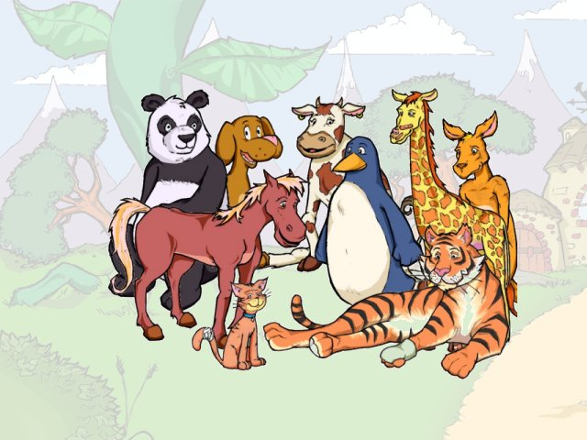
Frayer Model: Modified for Special Populations
Definition Any living things that are not a plant or a human | Sentence The animal walked across the field.
Synonym/Antonym Pig/cerdo Plant/planta | Picture
Animals/animales

Slide 14
Useful Web Sites
Student –friendly definitions
http://www.oup.com/elt/catalogue/teachersites/oald7/?cc=global
Idioms
http://dictionary.cambridge.org/results.asp?dict=A
Math terms
http://www.mathwords.com/

