Slide 1
Think-Turn-Talk
A Presentation for Middle School and High School Teachers
Notes:
Introduce yourself and welcome participants.
Say: Let’s begin by reviewing the materials you need for this training.
(Hold items up as you talk.)
Say: You have 2 sets of handouts. You should have 1 set that says Think-Turn-Talk PowerPoint Handout, and one that says Additional Handouts.
Now that we have all of our materials ready, let’s begin our session.

Slide 3
Big Ideas
Routine for engagement & comprehension
Intentional use of questioning
Planning in advance of the lesson
Notes:
Say: On your handout, I’d like you to write down the following big ideas.
Click for each bullet and read slide.

Slide 4
Session Goals
Reinforce the importance of planned discussions during lessons.
Focus on an instructional routine (Think-Turn-Talk) to increase student engagement through planned discussion.
Experience using Think-Turn-Talk.
Practice and plan to use the Think-Turn-Talk routine.
Notes:
Say: We have four goals during this session:
Read first two bullets.
Say: Think-Turn-Talk is a powerful instructional routine that may also be known as Think-Pair-Share (Lyman, 1981). How many of you have used this routine in your classroom?
Provide time for audience to respond.
Say: You may have used this routine in your classroom as a way to promote student involvement and increase discussion (McTighe & Lyman, 1988), or because you know that “students with learning disabilities prefer to work in pairs” (Vaughn, Hughes, Moody & Elbaum, 2001).
This may not be a new routine to you, but today we are going to address ways to use Think-Turn-Talk more often and more effectively. This cooperative learning routine is equally effective for both young students and adult learners. Remember, our goal in TLI is to work toward consistency and alignment across all age/grade level.
First we will talk about why the routine is effective, then we will discuss how to implement the routine as part of your daily instruction, and finally we will practice and plan to use the Think-Turn-Talk routine.

Slide 5
Think-turn-talk?
Why should we use
Notes:
Read slide.

Slide 6

The Power of Think-Turn-Talk
  Engagement
  Comprehension
  Think-time
  Process Information
  Safer Environment
  Application
  Accountability
  Assessment
Notes:
Say: There are a number of benefits when we implement the Think-Turn-Talk routine. Let’s look at these benefits more in-depth.

Slide 7
Engagement
“Student motivation and engagement should have a high priority in efforts to improve adolescent literacy outcomes.” One powerful method proven to increase motivation, is when teachers create opportunities for students to engage in discussions focused on learning and understanding from text.
(Torgesen et al., 2007, pp. 53-54)
Notes:
Say: Think-Turn-Talk helps all learners to listen and engage in the lesson. Dylan Wiliam (2005) asks, “The big question is: who is doing the thinking in the classroom?” Researchers who have studied exemplary teachers found that the most accomplished teachers were able to promote high levels of student engagement in their lessons and had well-established routines in place(Taylor, Pearson, Clark & Walpole, 1999). We must ensure that all students are thinking and that all students are engaged in our lessons. Joe Torgesen says,
Read slide.

Slide 8
Comprehension
Participation in text discussion during reading is a direct way to increase students’ ability to think about and learn from text.
High-quality discussion of difficult text can significantly enhance student comprehension.
“Taking time to build deep understanding through discussion must necessarily affect the breadth of content covered in a given class.”
(Torgesen et al., 2007, pp. 38-39)
Notes:
Say: Think-Turn-Talk also supports student comprehension of text.
Review bullets.
Say: Think-Turn-Talk provides think-time (also referred to as wait-time) for all students, but especially for those who need it. Let’s consider think-time. How long do you predict think-time usually lasts after a teacher asks a question?

Slide 9
Think-time
Positive effects on students:
“The length and correctness of their responses increase.
The number of their ‘I don't know’ and no answer responses decreases.
The number of volunteered, appropriate answers by larger numbers of students greatly increases.
The scores of students on academic achievement tests tend to increase.”
(Stahl, 1994)
3 seconds
1.5 seconds
Notes:
Click for 1.5 seconds to appear.
Say: Mary Budd Rowe (in Stahl, 1994) was the first to investigate wait-time/think-time (periods of silence that followed teacher questions and students' completed responses). She found that think-time “rarely lasted more than 1.5 seconds in typical classrooms” (Stahl, 1994). Often, shorter amounts of think-time are provided to students who are perceived as “slow” or “poor” learners (Cotton, 2001). Researchers have discovered, however, that when these periods of silence lasted at least…
Click for 3-5 seconds to appear.
Say: 3 seconds, many positive things happened to both students' and teachers' behaviors and attitudes.
Click for positive effects on students to appear. Read slide.

Slide 10
Think-time
Positive effects on teachers:
“Their questioning strategies tend to be more varied and flexible.
They decrease the quantity and increase the quality and variety of their questions.
They ask additional questions that require more complex information processing and higher-level thinking on the part of students.”
(Stahl, 1994)
Notes:
Say: Think-time not only provided benefits for students. It also impacted teachers’ behavior.
Read slide.
Say: The threshold of at least 3 seconds is important to receive the benefits of Think-Turn-Talk. One thing to keep in mind however, is that “A number of studies suggest that teachers appear to have difficulty utilizing a wait time of 3 seconds or more” (Tobin, 1987). Even when teachers were asked to wait, they often moved on before 3 seconds had passed. In other words, it’s hard for us to wait, so we must make a conscious effort to do so! Think-Turn-Talk is a routine that can help us make that conscious effort.

Slide 11
Process Information
“Teachers need to keep attentional demands to short bursts of no longer than the age of their learners in minutes. For a 1st grader, that’s about 6 consecutive minutes; for a high schooler, that’s up to 15 minutes.
Teachers ought to spend 55-80 percent of their time allowing students to process information.”
(Jensen, 1998, pp. 43-44)
Notes:
Say: If we use this strategy every few minutes, learners tend to be able to sit and focus for longer periods of time.
Read slide.

Slide 12
Safer Environment
“Students with LD prefer to work in pairs (with another student) rather than in large groups or by themselves.”
      (Vaughn, Hughes, Moody & Elbaum, 2001, p. 134)
      Be thoughtful when creating pairs or students or small groups of students together to share their thinking.
Notes:
Say: This routine provides opportunities for quieter students to share their thinking in a safe environment.
It’s important for us to know that “students with LD prefer to work in pairs (with another student) rather than in large groups or by themselves” (Vaughn, Hughes, Moody & Elbaum, 2001).
Another point to keep in mind is how we pair or group students when sharing their thinking. Anita Archer (2007) suggests that you may wish to pair more introverted students together so that they are not overwhelmed by more gregarious students.

Slide 13
Application
“…the brain learns best when it ‘does’, rather than when it ‘absorbs’ [Pally, 1997]. Thus, all students must think at a high level to solve knotty problems and to transform the ideas and information they encounter.”
(Tomlinson & Kalbfleisch, 1998, p. 54)
Notes:
Say: Think-Turn-Talk allows students to apply learned strategies or skills in context. Brain research tells us that
Read slide.

Slide 14
Accountability
Think-Turn-Talk sends a message to students that they are all accountable for the thinking during the lesson.
“Dead time interferes with students' learning, and it is contagious. It lures those who are on task into wondering, ‘Why should I pay attention if others aren't?’"
http://www.edutopia.org/classroom-student-participation-tips
Notes:
Say: The Think-Turn-Talk routine also provides built-in accountability. When all students have the expectation that they may be called upon to share their thinking with the whole group, they learn to use the talk-time to clarify their thinking. For example, you may inform students: “I will ask three of you to share your thinking with the whole class after you have had time to talk with your partner.”
When using this routine, it is not necessary for students to raise their hands to answer questions. They should each be prepared to answer when they are randomly called upon.
Read second bullet.
Say: Debbie Miller (2002) says that, “The time we spend thinking out loud… sets the tone… Children come to understand that I expect a respectful, thoughtful, time-to-listen-and-learn-from-each-other frame of mind.”

Slide 15
Assessment
Many teachers take notes of what they hear students discussing. The qualitative data enhance the quantitative data that we collect through formal assessments. We can use the evidence we hear, as students discuss, to adapt instruction to meet student needs. When we use effective questions and take time to ask students, “What makes you think that?” we show them that we are truly interested in what they think.
(Wiliam, 2005)
Notes:
Say: Think-Turn-Talk can be used as an anecdotal assessment tool. When students are sharing with their partners, it is important to listen to their conversations. Many teachers place a list of student names on a clipboard and make note of what they hear at these times. The qualitative data enhance the quantitative data that we collect through formal assessments. This evidence aids us in adapting instruction to meet student needs.
This “listening in” also helps us build relationships with our students. When we use effective questions and take time to ask students, “What makes you think that?” we show them that we are truly interested in what they think (Wiliam, 2005).

Slide 16
The Power of Think-Turn-Talk
  Engagement
  Comprehension
  Think-time
  Process Information
  Safer Environment
  Application
  Accountability
  Assessment
Notes:
Say: You’ve now heard how powerful this routine can be. We call it a routine because that is how we want to view this instructional practice. It should be routine, part of our everyday instruction. It’s what effective teachers do to keep students engaged in learning.

Slide 17
Let’s Practice!
Think
Turn
Talk
How might the implementation of Think-Turn-Talk make a difference in your classroom?
Notes:
Say: Now that we know why this strategy is so powerful, we’ll examine one way the routine might be used in a classroom.
Because you are adults, I am going to have you select your own partners. Take five seconds to find a partner at your table.
Allow participants five seconds to find partners.
Say: Having a structured routine is important to the success of Think-Turn-Talk. With younger students We give our students oral and visual cues for all of the steps. I will share one set of signals with you now. You may decide if this will be a helpful scaffold to use with your students. If you choose to use hand signals, consistency is crucial. Use the same signals each time you use the routine. You may wish to consider signals that use only one hand. This might be easiest to manage since you may often have a book in the other hand.
Say: Ready to practice? Here is the question I want you to think about:
Click to reveal questions.
Say: How might the implementation of Think-Turn-Talk make a difference in your classroom?
I will give you 8 seconds to think about your answer.
Say: Think
After 8 seconds, click for next word to appear.
Now you have 20 seconds each to turn and talk with your partner about your favorite book.
After 40 seconds say: Five, four, three, two, one. Eyes on me. Thank you for giving me your attention.
Say: Instead of taking this time to share how the implementation of TTT makes a difference in your classroom, let’s think about the routine we just experienced.

Slide 18
Think
How were you affected by having 8 seconds to consider your answer?
3-5 Seconds
Notes:
Read slide.
Allow 8 seconds of think-time and then ask 2-3 participants to share responses with the whole group. If time allows, you may use numbered popsicle sticks to randomly select those who will share.
Say: Often, responses fall into one of two groups: I liked having time to think about my response or It made me uncomfortable to have to sit quietly because I was already prepared to respond.
Students often fall into one of these two categories as well. Some are eager to respond, raising their hands before the question is even completely asked; others need time to process both the question and the answer. Neither of these response methods is better than the other; we simply process things differently.
Think-Turn-Talk provides benefits for both types of students.
In this example, we gave you eight seconds.
Click to reveal text: 3-5 seconds.
Say: Teachers should deliberately and consistently provide think-time of at least 3-5 seconds after asking a question. Longer think-time may be necessary in particular situations.
Think-time should also be provided after students respond to a question. This allows the student to fully complete a response. It also allows other students to consider what their classmate has said before offering their response.

Slide 19
Think-Turn-Talk
Intentionally Plan Opportunities for
Notes:
Read slide.

Slide 20
When Can You Use Think-Turn-Talk?
Every lesson…
Every day...
Every content area…
Notes:
Read heading.
Say: We may have used Think-Turn-Talk intuitively or sporadically in the past. We may have done it a few times a week or maybe when we were being observed and had extra time to plan a lesson. We can change the way we think about Think-Turn-Talk, making it both intentional and routine – an approach that we use almost EVERY time we ask a question that engages students in higher-level thinking. In fact, we can use it in…
Click 3 times and read each line.
Say: Most teachers have experienced the following: we ask a question of the class, but find the same few students raise their hands while the rest of the class remain silent. Many students have learned to allow the eager-responders to do the thinking work for them. Remember, the most accomplished teachers have high levels of student engagement and are more likely to ask higher level questions (Taylor, Pearson, Clark & Walpole, 1999). When Think-Turn-Talk becomes a part of the classroom routine, ALL students are expected to think and they are given extra opportunities to practice skills and strategies.
In particular, Think-Turn-Talk can help us find additional times during the day to teach reading comprehension strategies. For example, we often struggle to find time to teach and reinforce strategies while reading expository text. If, however, we use Think-Turn-Talk in all content areas, we have an opportunity to teach comprehension outside of our literacy block. We can also ensure that our students are focusing on the information we’d like them to glean from content area text.

Slide 21

Process Information
“Teachers ought to spend 55-80 percent of their time allowing students to process information.”
(Jensen, 1998, p. 44)
Notes:
Say: By using Think-Turn-Talk, we can create these processing opportunities throughout the instructional day.
Let’s take a moment to process the information that we have discussed so far. We’ve shared research that validates the power of Think-Turn-Talk, we’ve practiced the routine, and we know that processing time is crucial to learning in all subject areas.
Pause.
Say: What are you thinking now? Let’s go back to the question I asked you to think about a few slides ago, How might the implementation of Think-Turn-Talk make a difference in your classroom?
Think for a moment… (model the hand signal and allow for think-time).
Say: Turn and talk with your partner (model the hand signals as you say turn and talk).

Slide 22

Planning
Explicitly discuss expectations with students for how they are to share their thinking with a partner or group
Think about how you will pair or group students
Randomly select students to share thinking with the whole class
http://youtu.be/X02F9DlkPJg
Notes:
Say: If we would like Think-Turn-Talk to become a classroom routine, how do we implement it effectively?
Read first bullet.
Say: You will want to model and practice the strategy several times so that expectations are clear. Without practice, this strategy will not be successful.
Read second bullet.
Read third bullet.
Say: When you would like students to share with the whole class, using a random selection method will help build in accountability for the students. Often, their talk will be more focused if they know that ANYONE could be called on. Here is an example for how you might use a Smart Board. The random word chooser or random picture chooser works well.

Slide 23
Planning
Plan stops and questions well in advance.
Where will you stop?
Why will you stop there?
  What is the critical information?
  Is there a part that students will need support in understanding?
  How long have students been focused without an opportunity to interact?
Notes:
Say: It’s critical that Think-Turn-Talk be planned well in advance. In thinking about a specific text ask: Where will you stop to ask questions? Why will you stop there? What question prompt will you use?
We might look for a spot that has critical information we don’t want our students to miss; we might think about which parts could be confusing to our students; and we think about how long they have had to sit and listen.

Slide 24
Planning
Ask questions that involve critical thinking, opinion, or an extended answer.
Specific: “Why does …?”
General: “What are you thinking?”
Ask questions that relate to the CPQ.
Ask questions that reinforce the cognitive strategy you are focusing on in the lesson.
Write questions on sticky notes and place them in your copy of the text as a reminder where to stop and what question you will ask.
Notes:
Say: Question prompts are used to engage students in discussion for Think-Turn-Talk. You may choose to use questions that are more specific to a particular text, such as asking what motivates a character’s actions.
You might also just use a generic question such as, “What are you thinking now?”
In choosing questions, you may refer back to the Comprehension Purpose Question (CPQ) so that students can reflect on the CPQ and continue to gather information that will help them to answer the CPQ.
When possible, we also try to connect Think-Turn-Talk to the comprehension strategy we are studying.

Slide 25
Planning
After a student shares their thinking, ask them to expand on their answer and explain why they think what they do.
Follow-up student sharing with immediate and corrective feedback.
Notes:
Say: Whatever the question we choose, it should be one that allows our students to express their thinking. Questions that have only one correct answer, or where the answers can be found “right there” in the text, do not prove as effective for use with the Think-Turn-Talk routine.
Read first bullet.
Say: Researcher Janet Wilde (1998) says, “Teachers can encourage children to make their understanding explicit by talking about it. Research shows that students who talk about how they and others think become better learners.”
Because we have thought carefully about our questions, we do not want to forget them in our actual implementation of the lesson. If we write our Think-Turn-Talk question on a sticky note and place it on the page where we plan to use it, we have a good reminder to ourselves. Because student engagement is so important, we must make sure that we don’t forget our planned discussions.
We also want to follow-up on student responses with immediate and corrective feedback. Let’s take a look at two ways we provide feedback.

Slide 26
Features of Effective Instruction
Immediate and Corrective Feedback
1. Describing why an answer is correct.
Examples:
Describing why the work was good/well done
Commenting on specific word usage
Explaining correct responses by one student to the whole class
Confirming a student’s performance
(Texas Education Agency/University of Texas System, 2007)
Notes:
Say: Providing feedback that is descriptive, making specific references to a student’s achievement can relate to student improvement. Ways to describe why an answer is correct are:
Read bullets.

Slide 27
Features of Effective Instruction
Immediate and Corrective Feedback
2. Specifying or implying a better way of doing something.
Examples:
Advising students to begin a task again
Modeling expectations again
Building on a student’s response
Asking students to compare with other examples
Showing students how to make specific corrections
(Texas Education Agency/University of Texas System, 2007)
Notes:
Read bullets.

Slide 28
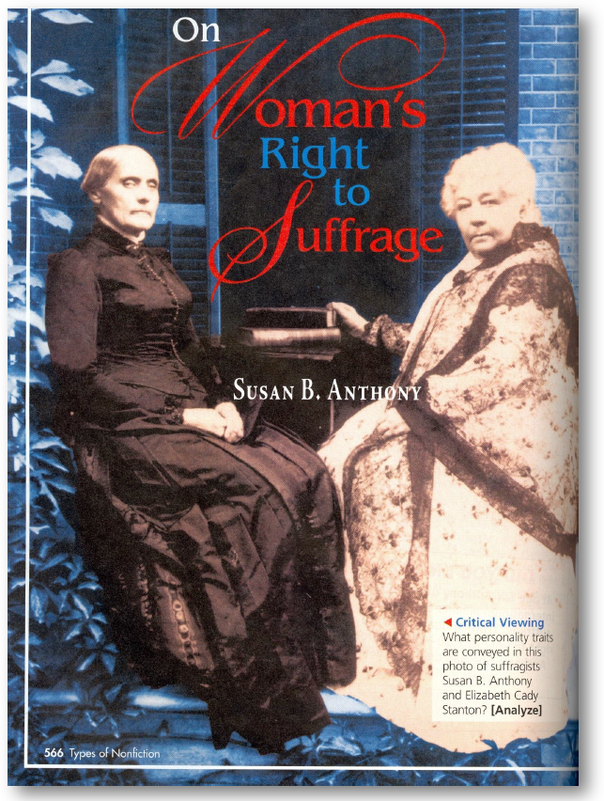
Handout #1
CPQ: What are the key points to Susan B. Anthony’s argument for why women should get to vote?
Texas Literature: Language and Literacy. (2011). Upper Saddle River, NJ: Pearson Education Inc.
Notes:
Say: Let’s explore how this might look in the classroom.
Handout #1.

Slide 29

Which part of the Constitution is she referring to when she says that she simply exercised her citizen’s rights?

Slide 30
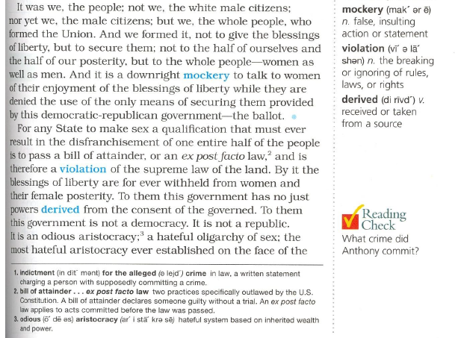
Why does she say it’s a mockery? What is she talking about?

Slide 31
What does she mean in this part of her argument?

Slide 32
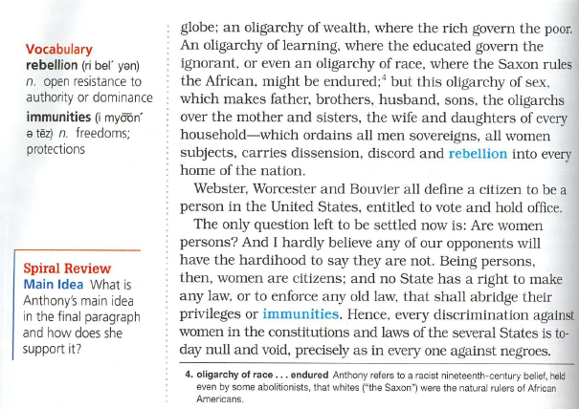
Why does she think that the government is an oligarchy and how will it cause a rebellion?

Slide 33
CPQ: What are the key points to Susan B. Anthony’s argument for why women should get to vote?
Texas Literature: Language and Literacy. (2011). Upper Saddle River, NJ: Pearson Education Inc.

Slide 34
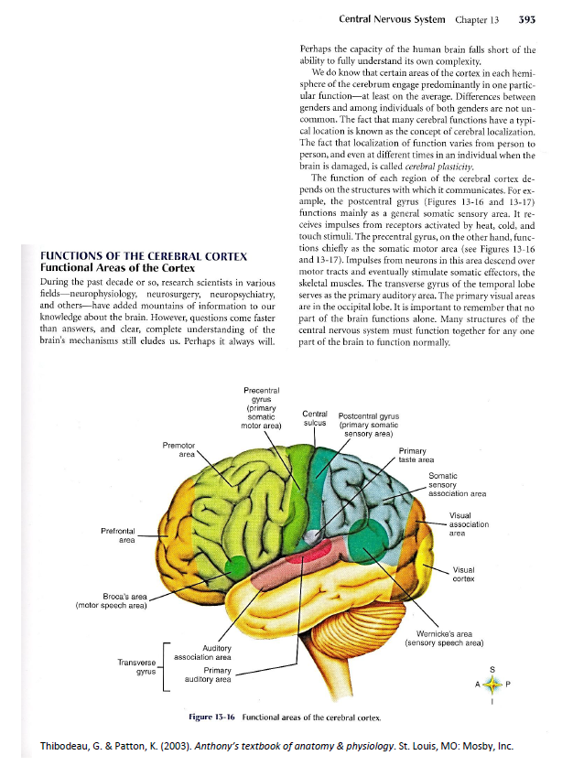
CPQ: What is important to understand about functional areas of the cortex?
Handout #2
You Do!
Read Functions of the Cerebral Cortex.
Track your thinking as you read.
Plan 3 places where you would ask students to stop and answer a TTT question.
Share your questions with a partner.
Thibodeau, G. & Patton, K. (2003). Anthony’s textbook of anatomy & physiology. St. Louis, MO: Mosby, Inc.
Notes:
Read slide.
Handout # 2.

Slide 35
“Teachers do not create learning. Learners create learning. Teachers create the environment for learning.” (Wiliam, 2005)
Notes:
Click to reveal quotation.
Read quotation.

Slide 36
References
Cotton, K. (2001). Classroom Questioning. School improvement research series, Close-up #5. NWREL. Retrieved February 28, 2008, from http://www.nwrel.org/scpd/sirs/3/cu5.html.
Edutopia.org. (n.d.). Retrieved on November 19 from http://www.edutopia.org/classroom-student-participation-tips.
Jensen, E. (1998). How Julie’s brain learns. Educational Leadership, 56(3), 41-45.
Lyman, F. (1981). The responsive classroom discussion: The inclusion of all students. In A. Anderson (Ed.), Mainstreaming Digest (pp. 109–113). College Park, MD: University of Maryland Press.
Stahl, R. (1994). Using “Think-Time" and “Wait-Time" Skillfully in the Classroom. ERIC clearinghouse for social studies/social science education ERIC digest. Bloomington, IN. Retrieved February 28, 2008, from http://www.ericdigests.org/1995-1/think.htm.
Texas Literature: Language and Literacy. (2011). Upper Saddle River, NJ: Pearson Education Inc.
Thibodeau, G. & Patton, K. (2003). Anthony’s textbook of anatomy & physiology. St. Louis, MO: Mosby, Inc.

Slide 37
References
Tobin, K. (1987). The role of wait time in higher cognitive level learning. Review of Educational Research, 57(1), 69-95.
Tomlinson, C., & Kalbfleisch, M. (1998). Teach me, teach my brain: A call for differentiated classrooms. Educational Leadership, 56(3), 52-55.
Torgesen, J. K., Houston, D. D., Rissman, L. M., Decker, S. M., Roberts, G., Vaughn, S., Wexler, J. Francis, D. J, Rivera, M. O., Lesaux, N. (2007). Academic literacy instruction for adolescents: A guidance document from the Center on Instruction. Portsmouth, NH: RMC Research Corporation, Center on Instruction. Retreived on November 6, 2012 from http://www.centeroninstruction.org/files/Academic%20Literacy.pdf.
Vaughn Gross Center for Reading and Language Arts. (2007). Features of effective instruction. University of Texas System/Texas Education Agency.
Vaughn, S., Tejero Hughes, M., Watson Moody, S., & Elbaum, B. (2001). Instructional grouping for reading for students with LD: Implications for practice. Intervention in School and Clinic, 36(3), 131-137.
Wiliam, D. (2005, November). Assessment for learning: The research evidence. Presentation given at the Alberta Assessment Consortium Conference, Calgary, AB.

